Slide 1
N-th Order Approximation: Shifted Beam
May 24 2020
Computation times
Tophat ,varied max mode order
Gaussian
Shifts up to 100 micron

Slide 2
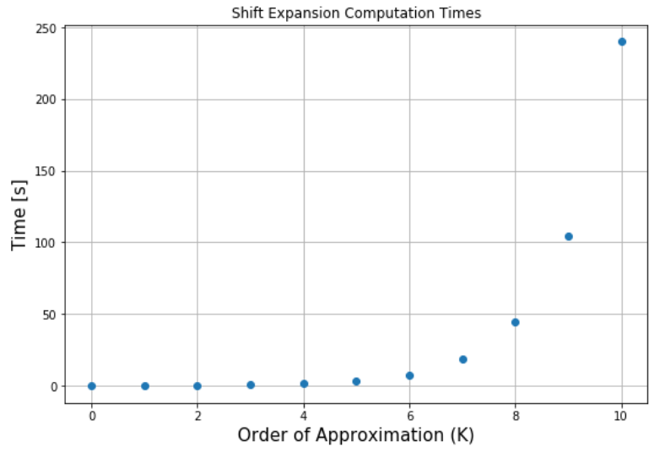
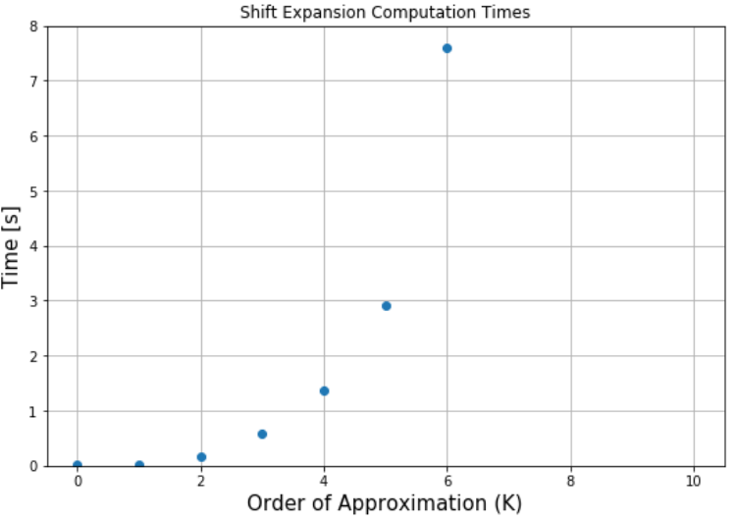
Performing the expansion for updated C_{nm} ( no signal calc. or tilt)
Up to 10th order:
a¹⁰ terms
x¹⁰ terms
Mode order 34 tophat -> order 44 after x transformations
Computation Times
[0.015625, 0.015625, 0.15625, 0.59375, 1.359375, 2.921875, 7.609375, 18.953125, 44.234375, 104.390625, 240.046875]

Slide 3
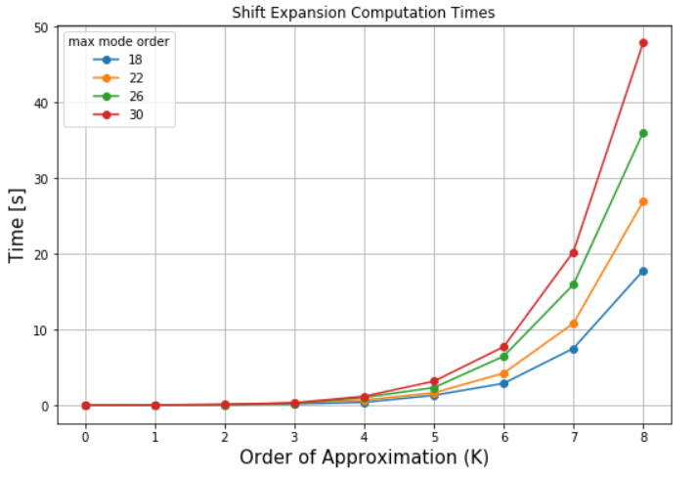
Computation Times: Varying Tophat Max Mode Order
Same scenario as previous slide
Times shown below
Time ~double from mode 18 to 26
~O(n²) …

Slide 4
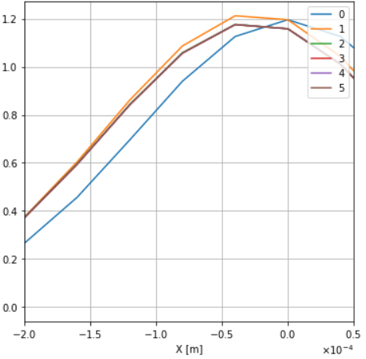
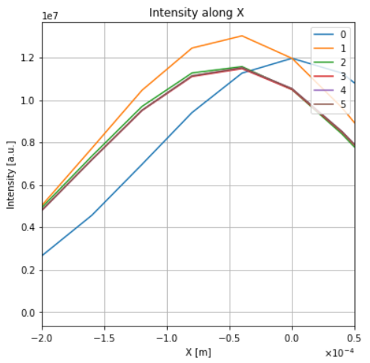
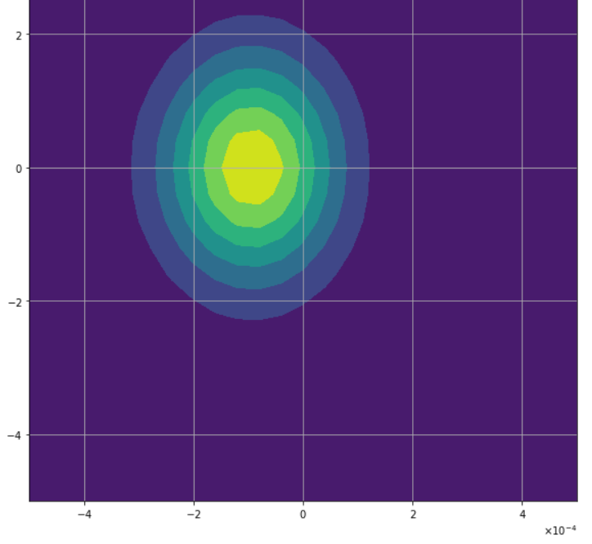
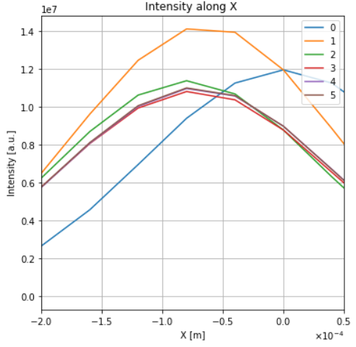
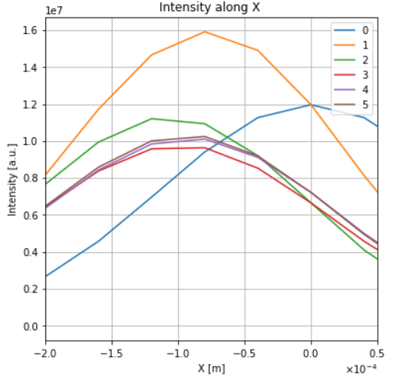
Shifted Gaussian
Intensity contour (100 micron) right
Intensity at y=0 below
Vertical lines show expected shift
(L to R: 25,50,75,100um)
Intensity (a=100um,5th order)

